Slide 1
Understanding VASP Power Profiles on NVIDIA A100 GPUs
Zhengji Zhao, Brian Austin, Ermal Rrapaj, and Nicholas Wright
National Energy Research Scientific Computing Center (NERSC),
Lawrence Berkeley National Laboratory
PMBS24, held in conjunction with SC24
Atlanta GA
November 18, 2024

Slide 2
Introduction

Slide 3
Power has Become a key Limiting Factor in HPC
System (Installation Year) | Performance (PFLOPS) | Power (MW) | Energy Efficiency (GFLOPS/W)
Frontier (2021) | 1,206 | 22.8 | 52.9
Aurora (2023) | 1,012 | 38.7 | 26.2
Fugaku (2020) | 442 | 29.9 | 15.4
Perlmutter (2021) | 79.2 | 2.9 | 26.9
HPC systems must operate efficiently within a limited power budget, necessitating application-aware power management.
Numbers from https://top500.org/lists/top500/2024/06/
Notes:
As HPC transitions into the exascale era, power has emerged as a critical limiting factor. HPC systems must operate efficiently within a constrained power budget, which necessitates application-aware power management.

Slide 4
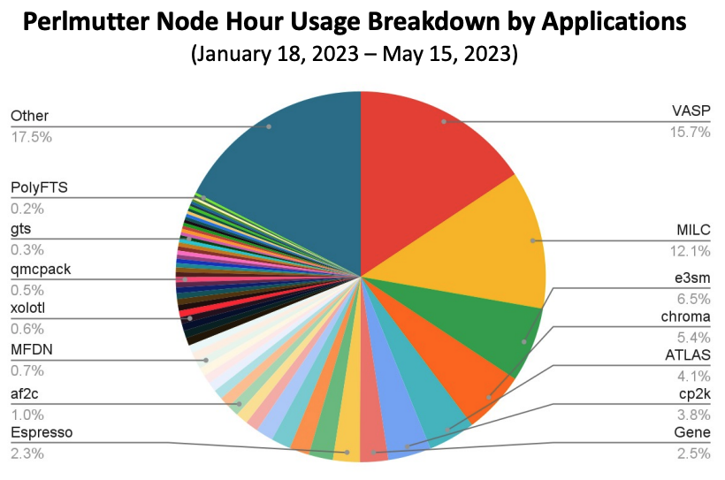
Motivation for an In-Depth Study of Leading Applications’ Power Behavior
Essential for effective power management
Challenges:
Outdated Research: Previous studies on older CPU/GPU generations lack relevance to modern GPU-centric HPC systems.
Limited Insights: Existing data only offers snapshots of application power behavior, inadequate for production-level power management.
Focus of Study: Analyze power behavior of the VASP application on NVIDIA A100 GPUs in the Perlmutter system at NERSC, and and evaluate its response to power capping to identify power management opportunities.
Notes:
To do so, it is essential to understand the power behaviors of applications. While many efforts over the past few decades have focused on older CPU and GPU generations, their relevance to modern GPU-centric HPC systems is questionable. Although some recent studies have explored application power profiles, they often provide only snapshots of broader power behaviors, lacking insights into how power consumption varies with different run conditions, inputs, and other factors. As a result, these studies fall short for effective production-level power management.
In this work, we analyze analyze the power behavior of a specific application, VASP, on NVIDIA A100 GPUs in the Perlmutter system at NERSC, and evaluate its response to power capping in order to identify potential power management opportunities.

Slide 5
System Configuration and Experimental Setup

Slide 6
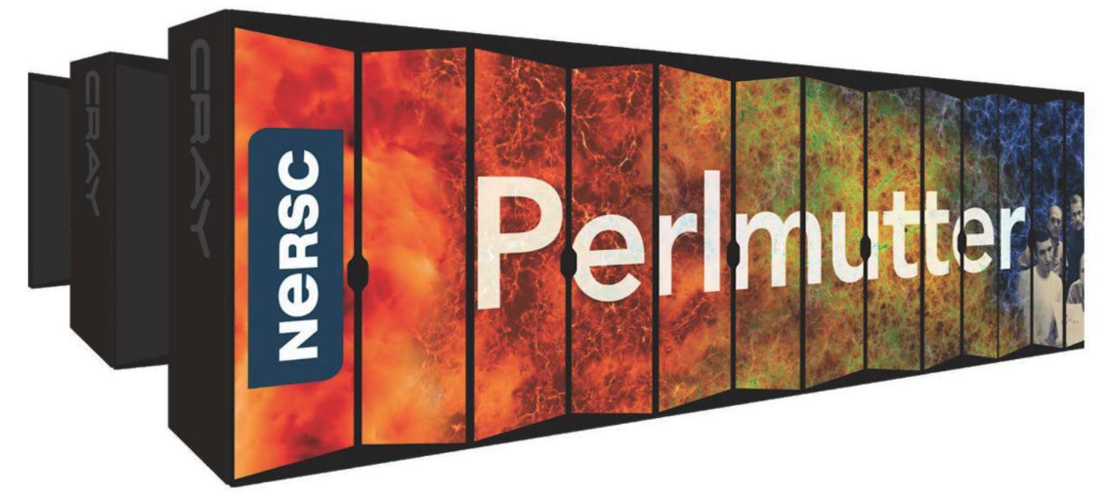
Perlmutter - HPE Cray EX System Based on AMD Milan CPUs and NVIDIA A100 GPUs
1882 GPU accelerated nodes with 1x Milan CPU and 4x NVIDIA A100 GPUs;
3072 CPU nodes with 2x AMD Milan CPUs;
Slingshot 11 interconnect
35 PB all Flash Lustre file system
Thermal Design Power (TDP)
CPU Socket | GPU Socket | CPU Node | GPU Node | System
280 W | 400 W | 823 W | 2,350 W | 6.9 MW
Node/Component Power Measurements:
Cray power monitoring (PM) counters
NVIDIA DCGM
Sampling rate: 2 seconds
Notes:
We did our experiments on Perlmutter at NERSC, an HPE Cray EX System. Perlmutter is a heterogeneous system with more than 1800 GPU accelerated nodes and 3000 CPU-only nodes. Each gpu accelerated node has 1 AMD Milan CPU and 4 NVIDIA A100 GPUs; and each CPU-only nodes has two AMD milan CPUs. This table shows the thermal design power (TDP) for Perlmutter CPU, GPU, nodes and system total. In this study, we used Cray power monitoring counters to measure node and its component power usage. The sampling rate of the power data is 2 seconds.

Slide 7
VASP: Vienna Ab-initio Simulation Package
Ab Initio materials science code, solving iteratively
𝚿_{i}(r): ”one-electron” orbitals (aka bands), expanded in a planewave basis ε_{i} : orbital energies
N : the number of orbitals
V(r): effective potential
Two major categories of computation:
Density Functional Theory (DFT) computations
Higher-order methods
Written mainly in Fortran 90 and parallelized with MPI and OpenACC for GPUs
Notes:
Depending on how the effective potential is treated, there are two main categories of computations in VASP.

Slide 8
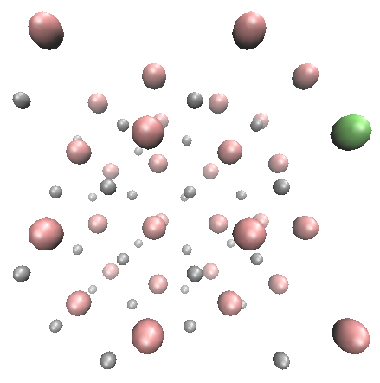
Benchmarks Were Chosen to Cover the Representative VASP Workloads and to Exercise Different Code Paths
Based on the VASP user survey at NERSC in 2023 and workload analysis
Designed to reflect day-to-day scientific runs instead of heroic runs
Seven benchmarks selected to represent VASP workloads:
Higher-order methods (compute/memory intensive):
Si256_hse
B.hR105_hse
Si128_acfdtr
DFT computations:
PdO4
PdO2
GaAsBi-64
CuC_vdw
Si256_hse
GaAsBi-64
Notes:
Choosing the right benchmarks is crucial for our in-depth study, as our goal is to understand VASP's production workloads. To ensure a comprehensive approach, we not only analyzed the workloads but also conducted a VASP user survey last year and consulted with VASP developers. Based on this, we selected 7 benchmarks that best represent the VASP production workloads at NERSC.

Slide 9
VASP Power Profiles

Slide 10
VASP has Widespread Power Usage and Different VASP Workloads Have Distinct Power Timeline Patterns
VASP's power usage is significantly below the node's thermal design power (TDP) and is primarily driven by the GPUs.

Slide 11
VASP Power Timeline Data Distribution is Multimodal
Notes:
For multimodal distribution data, the average may not effectively represent power usage (e.g., as seen in the third distribution on this slide). We need to identify a more suitable metric that better reflects the power usage of VASP, particularly in the context of applying power management strategies such as power capping.

Slide 12
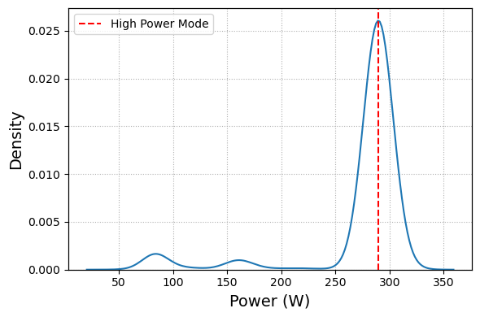
We use High Power Mode to Represent VASP Power Usage
Full width at half maximum
h
1
2
h
High Power Mode (HPM) is intended to describe the power usage of the core phase execution.
Full width at half maximum (FWHM) describes the power distribution near HPM.

Slide 13
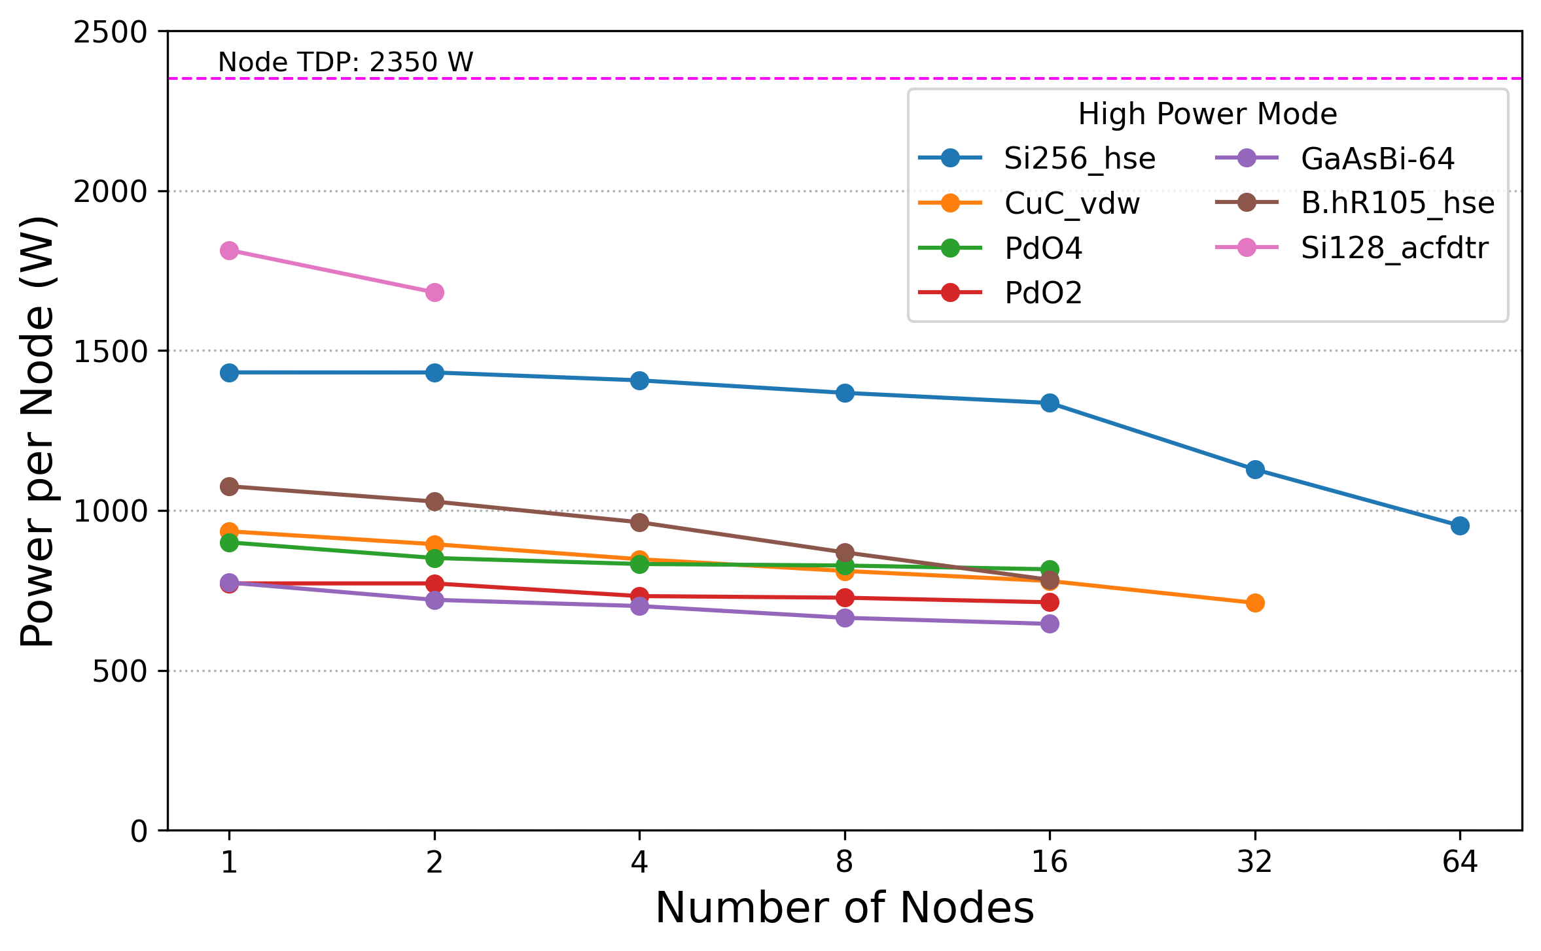
VASP’s Power Usage Varies Significantly with Workloads
Higher order methods
Do not scale to multiple nodes
Differences: problem sizes and chemical elements
Difference: problem sizes
DFT computations
Methods, problem sizes, and chemical elements all contribute to VASP's power variations to varying degrees.
VASP power changes gradually with parallel concurrencies.
Notes:
To understand the power behavior of VASP production workloads, we simulate typical user behavior by running selected benchmarks with different node concurrencies, including cases where VASP exhibits lower parallel efficiency (<70%). Let’s first examine the results for a single node.
The lower four data points represent DFT computations, while the remaining three points correspond to higher-order methods. Although the higher-order methods consume more power than the DFT methods, the brown dot, which represents an HSE computation, could arguably be grouped with the DFT computations. Although both the brown and blue dots are HSE calculations, the difference between them lies in problem size (105 atoms vs. 255 atoms) and chemical composition (silicon vs. boron). Even among the DFT computations, we observe that the green and red dots represent identical systems but with different sizes. This demonstrates that computational methods, problem size, and chemical elements all contribute to power variations in VASP to varying extents.
Next, let’s explore how parallel concurrency affects power usage. As expected, power consumption decreases with increasing node count, though the reduction is relatively gradual—especially when the code operates with high parallel efficiency (>70%). In fact, the rate at which power consumption decreases is influenced by the extent to which GPU computing resources are saturated at a single node.
To predict the power usage of a new VASP job, we must quantify the contributions of each of these factors. In our study, we systematically isolated each variable by fixing all others. For the sake of time, I will focus on just two key factors here. For a more detailed analysis, please refer to our paper.

Slide 14
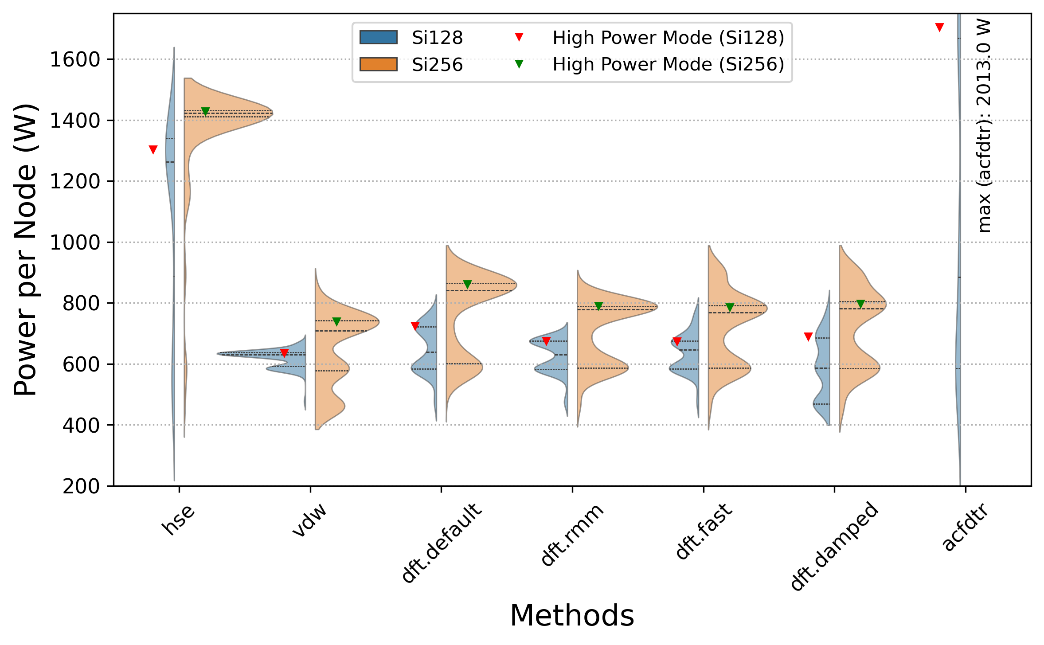
VASP Power Usage Changes Significantly Across Methods
VASP's higher-order methods, such as HSE and ACFDTR, consume significantly more power than standard DFT computations.
Notes:
First, let’s examine the contribution of each computational method to VASP's power consumption, while keeping all other variables fixed. For this analysis, we selected a silicon supercell with 128 atoms and applied different computational methods to this system. The blue violin plots represent the power distribution per node for each method, and the red triangles indicate the high-power mode for each method. As shown, higher-order methods (represented by the first and last red triangles) consume significantly more power than the various DFT methods. The power difference per node exceeds 600 W between the higher-order methods and DFT computations, while the difference between DFT methods is less than 100 W.
We repeated this analysis using a larger silicon supercell (255 atoms, shown in the orange violin plots and green triangles) and observed similar trends. Notably, we also see the effect of system size: as the system size increases, power consumption rises accordingly.

Slide 15
VASP Power Usage Changes Significantly Across Methods
VASP's higher-order methods, such as HSE and ACFDTR, consume significantly more power than standard DFT computations.
Notes:
First, let’s examine the contribution of each computational method to VASP's power consumption, while keeping all other variables fixed. For this analysis, we selected a silicon supercell with 128 atoms and applied different computational methods to this system. The blue violin plots represent the power distribution per node for each method, and the red triangles indicate the high-power mode for each method. As shown, higher-order methods (represented by the first and last red triangles) consume significantly more power than the various DFT methods. The power difference per node exceeds 600 W between the higher-order methods and DFT computations, while the difference between DFT methods is less than 100 W.
We repeated this analysis using a larger silicon supercell (255 atoms, shown in the orange violin plots and green triangles) and observed similar trends. Notably, we also see the effect of system size: as the system size increases, power consumption rises accordingly.

Slide 16
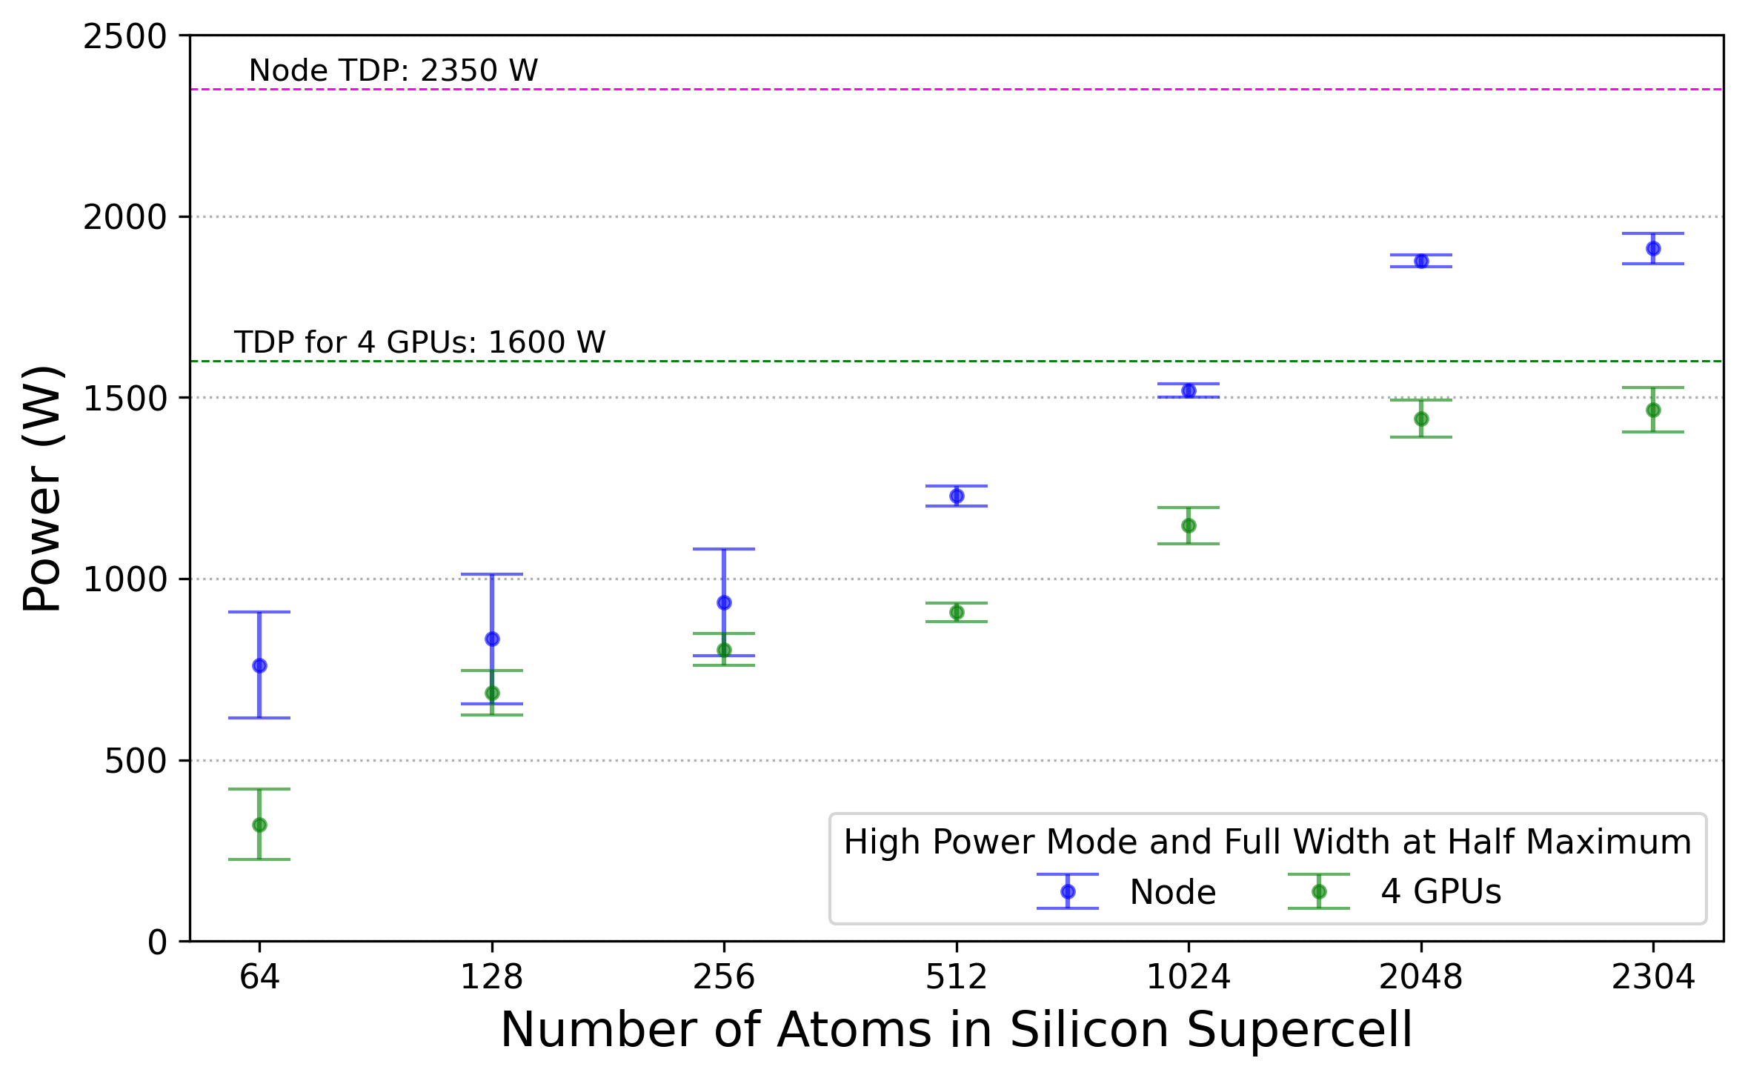
VASP Power Usage Increases with Problem Size
Power usage saturates when GPU power consumption approaches their Thermal Design Power (TDP).
Notes:
Next, let’s explore the effect of problem or system size. In this experiment, we vary only the problem size while keeping all other variables constant. Specifically, we applied the same DFT computation (dft.defaults) to a set of silicon supercells of different sizes. This figure shows the high-power mode and its full width at half maximum for a node and its four GPUs across supercells of varying sizes. As expected, power consumption increases with problem size, which is represented by the number of atoms in the system. However, power consumption eventually saturates when GPU power usage approaches their thermal design power (TDP).
One interesting observation is that around 2000 silicon atoms are required to fully saturate the GPU computing resources for DFT computations. This is significantly larger than typical DFT workloads, which are usually well below this threshold.

Slide 17
Key Findings on VASP Power Behavior
VASP’s power usage varies significantly across different workloads.
Higher-Order Methods: Higher-order methods, such as HSE and ACFDTR, consume significantly more power than standard DFT computations.
Impact of System Size: VASP power usage increases with system size.
Effect of Parallel Concurrency: VASP Power usage changes gradually with parallel concurrency increases.
Additional Studies: For more insights, such as the impact of internal parameters on power consumption, please refer to our paper.
Next Steps:
Develop a power prediction model for VASP based on these findings.
Deploy the model to optimize power consumption of VASP jobs on the Perlmutter system.
Notes:
Before moving on to the next part of the talk, let me briefly summarize our key findings regarding VASP's power usage. Please refer to our paper for more detailed information.

Slide 18
GPU Power Capping on VASP

Slide 19
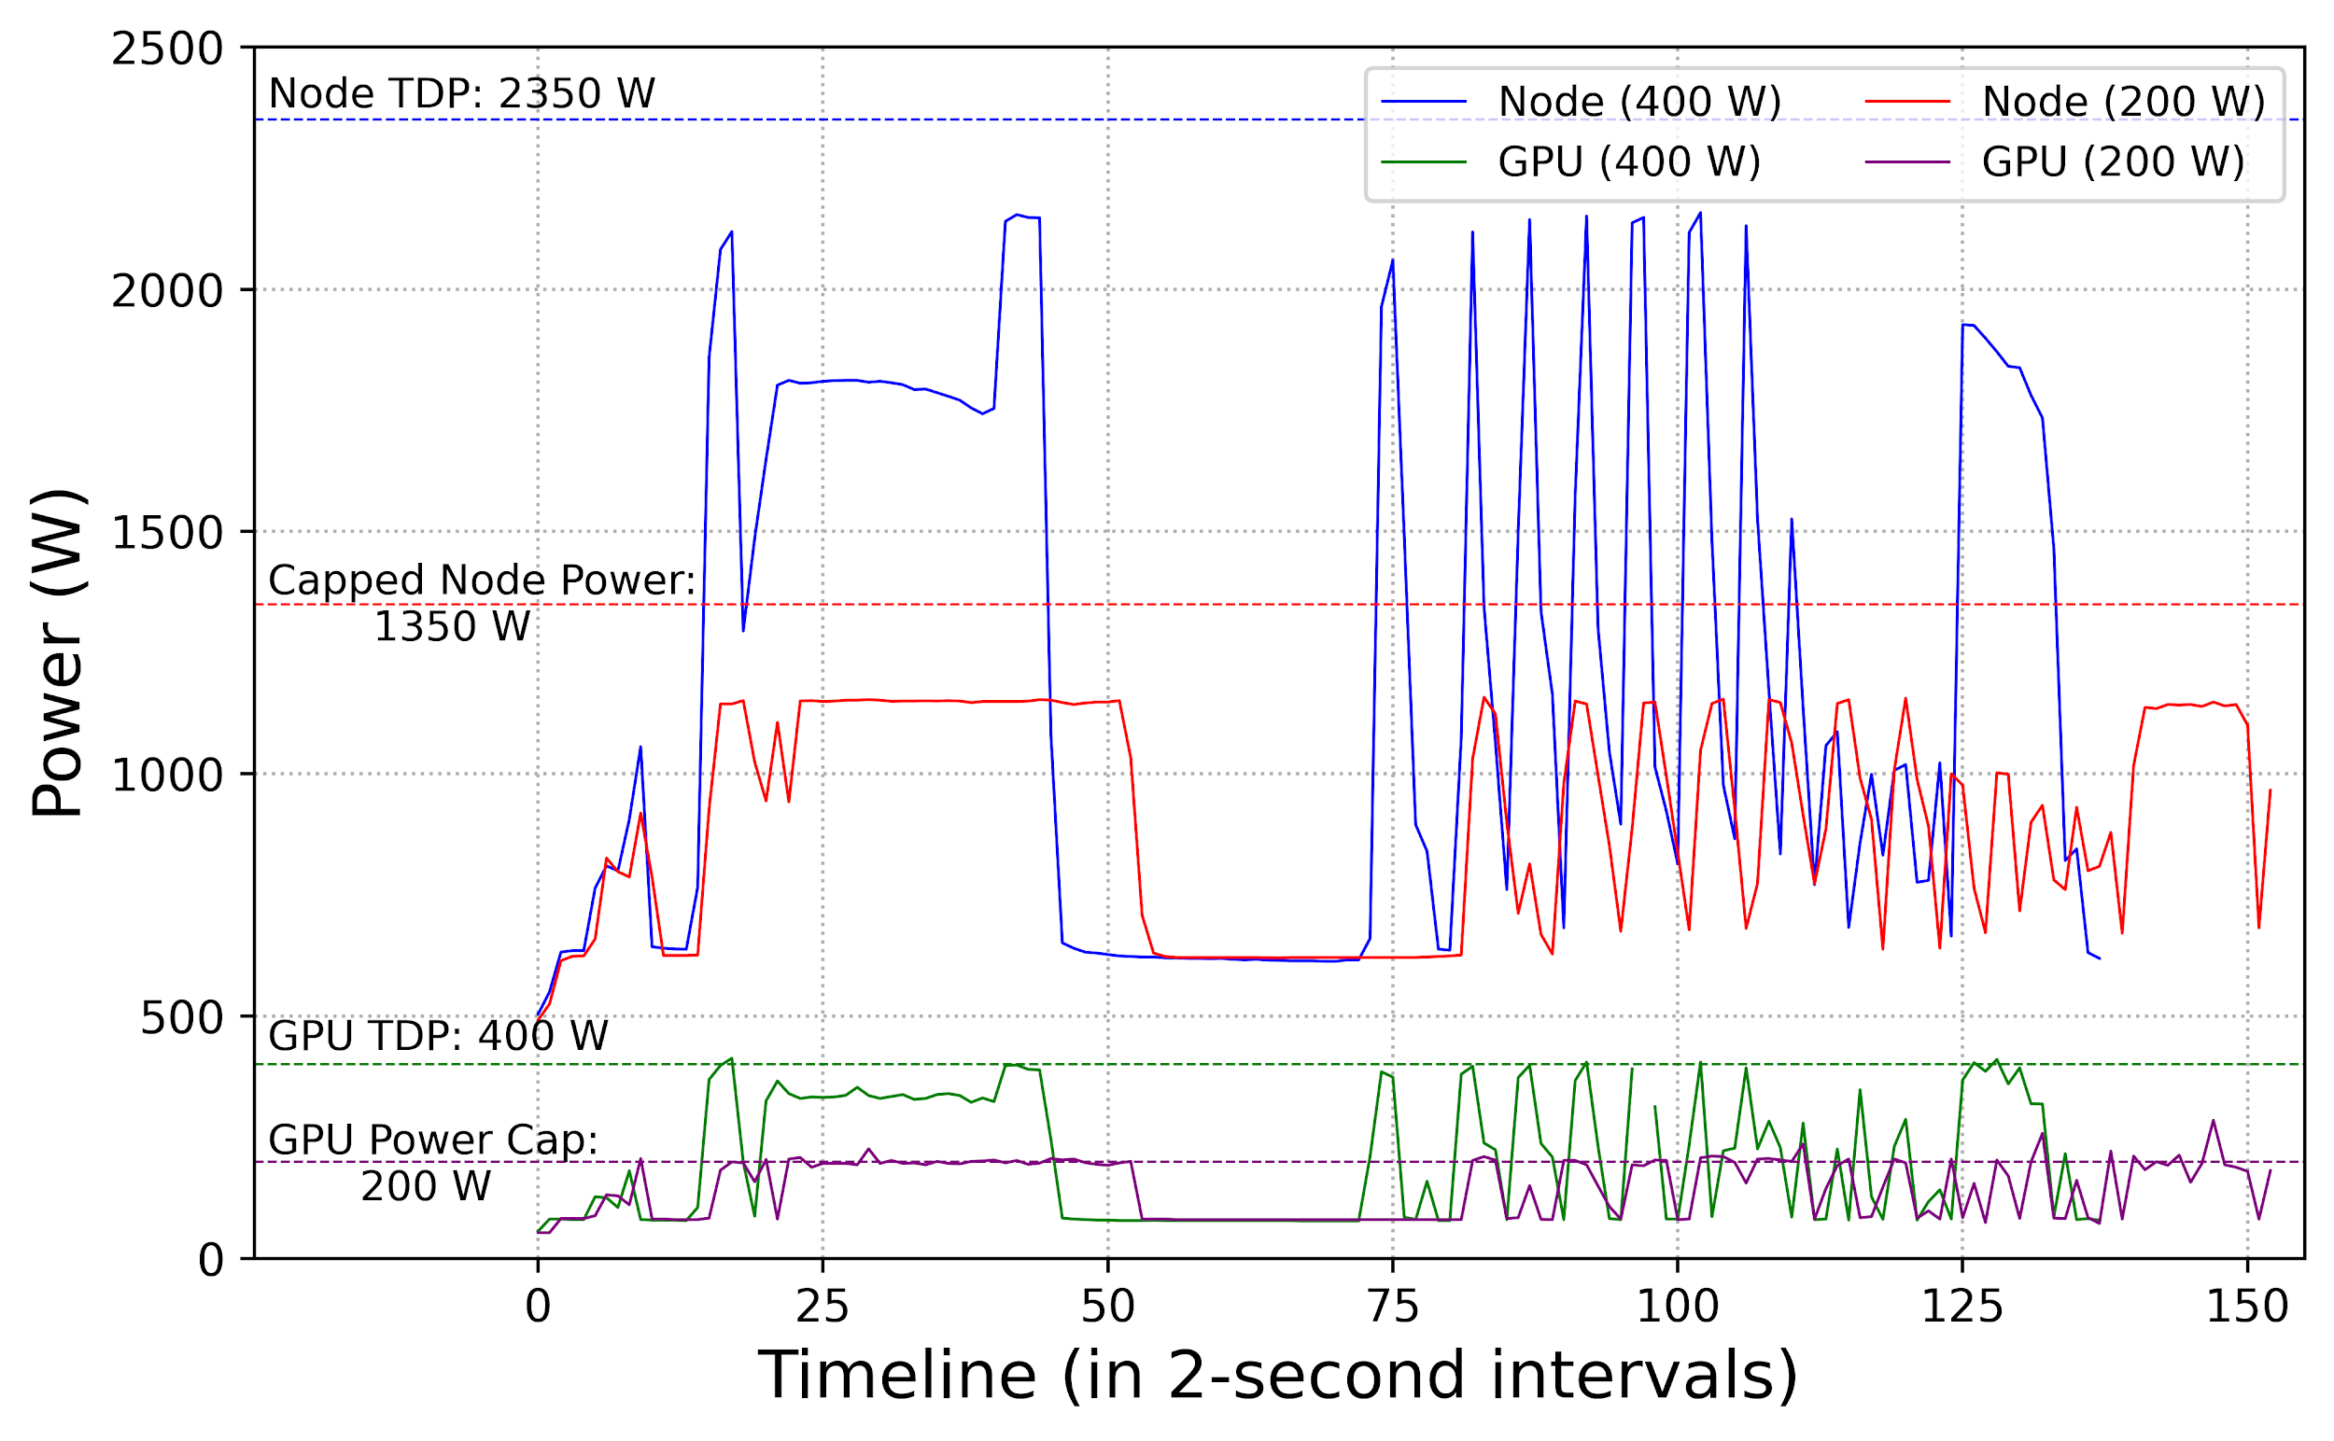
Power Capping Reduces Peak Consumption and Fluctuations
Si128_acfdtr
Capping GPU power to 200 W achieves:
47% reduction in peak power usage
10% slowdown
60% decrease in power fluctuation.
Notes:
Let’s examine the impact of GPU power capping using a benchmark example. This figure shows the power consumption for a node and one of its four GPUs under two different power limits. The blue and green lines represent the power consumption over time for the node and GPU under the default power limit of 400W on Perlmutter, while the red and purple lines show the power consumption with a 200W power cap applied.
As expected, power capping reduces overall power consumption (compare the blue and red lines). Specifically, the peak node power is reduced by 47%, with a 10% performance decrease.
Interestingly, while the peak power is significantly reduced, the troughs (minimum power levels) remain nearly the same. This results in a substantial reduction in power fluctuations. The magnitude of these fluctuations—measured from peak to trough—decreases by approximately 60%, and the frequency of these fluctuations slows down under power capping as well.

Slide 20
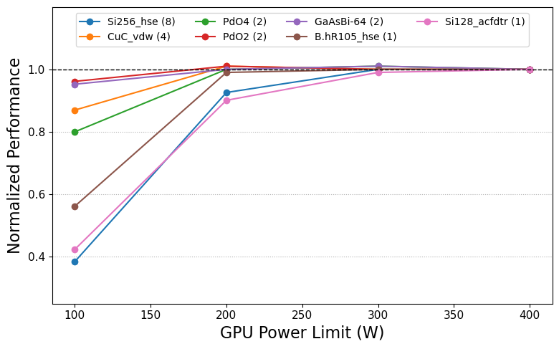
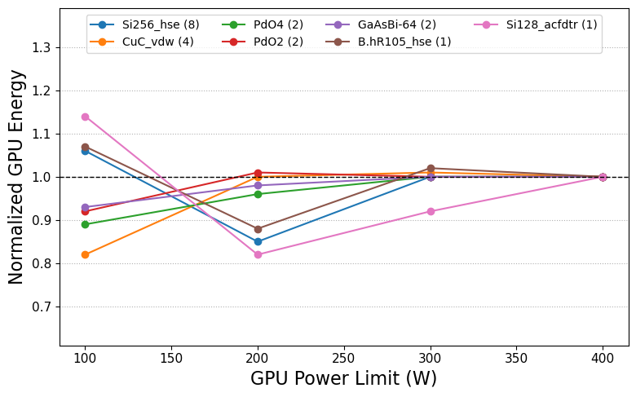
For Most VASP Workloads, Power Capping A100 GPUs at 50% TDP Results in Upto 18% GPU Energy Saving with Under 10% Performance Loss
50% TDP
TDP
50% TDP
TDP
Similar results with MILC, a lattice QCD code, “Analysis of Power Consumption and GPU Power Capping for MILC”, Fatih Acun et al, Sustainable Supercomputing 2024
Notes:
Now, let’s examine the effect of power capping across all selected workloads. In these experiments, we ran each benchmark at its optimal node count, which results in the shortest time to solution while maintaining parallel efficiency above 70%. The node counts are indicated in parentheses next to each benchmark name. On NVIDIA A100 GPUs, the power limit can range from 100W to 400W, with 400W being the system default on Perlmutter. The figure shows the performance (left) and GPU energy consumption (right) under different power limits, both normalized to the default 400W power limit.
The data reveals that for all workloads studied, capping the power of A100 GPUs to 50% of their thermal design power (TDP) results in up to a 10% performance decrease while yielding up to 18% GPU GPU energy savings (~ 13% total energy saving). These energy savings are most pronounced for higher-order methods (represented by the three lowest points in the right figure).
If we fine-tune the power cap for each benchmark, rather than applying a uniform 200W cap, we can achieve energy savings with minimal performance impact across all workloads. Furthermore, we can optimize the trade-off between performance and energy/power savings to better suit different job requirements.
These results are promising, as they suggest significant potential for reducing both the power budget and electricity costs, especially since VASP accounts for more than 15% of the computing cycles at NERSC. The unused power from VASP jobs (which often operate below 50% of GPU TDP) can be reallocated to more power-hungry workloads or drive more hardware, so that the center can stay within its overall power budget while still meeting the power demands of other jobs. It also leads to better utilization of the infrastructure investment in power and cooling systems at the center.
That being said, we must also take into account the productivity loss from the performance decrease (e.g., 10% lower throughput for VASP) and lowered utilization for the investment on the system procurement when applying power management strategies..

Slide 21
Summary

Slide 22
Summary
VASP’s power usage varies significantly across computational methods but gradually with parallel concurrency.
More generally, VASP's power consumption is highly sensitive to input parameters, as the workloads and various factors influencing power usage are specified in the VASP input files.
Power capping NVIDIA A100 GPUs at 50% of their Thermal Design Power (TDP) can be applied to most VASP workloads with less than a 10% performance loss, achieving up to 18% GPU energy savings.
These findings lay the groundwork for developing a VASP power prediction model, enabling application-aware power management in the future.
Scan to access full paper
Or use URL: https://shorturl.at/v8KdW

Slide 23
Acknowledgement
Chris Samuel, Robert Hamrick, and Ershaad Basheer at computational group at NERSC for enabling and supporting power capping experiments on Perlmutter.
Advanced Technologies Group members at NERSC for valuable feedback.
This work was supported by the Office of Advanced Scientific Computing Research in the Department of Energy Office of Science under contract number DE-AC02-05CH11231. It used the resources of the National Energy Scientific Computing Center (NERSC) at the Lawrence Berkeley National Laboratory.

Slide 24
Thank you!
Any questions?

Slide 25
Configurations and Benchmark Approach
VASP 6.4.1 (OpenACC and OpenMP ports)
Compiled with NVIDIA compiler 22.7
Libraries:
Cray MPICH 8.2.5; MKL from Intel oneAPI 23.0.0 and its FFTW3 wrappers to FFT; CUDA 11.7, QD, CUBLAS, CUSOLVER, CUFFT from HPCSDK 22.7; NCCL 2.15.5; HDF5 1.12.2.
Perlmutter runs HPE Cray OS 2.4 (SLES15SP4) and Slurm 22.05.8
Used LOOP+ time to measure performance where applicable, and elapsed time for energy/power tests
Repeated each test 5 times and selected the run with best performance
Notes:
too details put it as a backup slide

