Slide 1
Assessing the GPU Offload Threshold of GEMM and GEMV Kernels on Modern Heterogeneous HPC Systems
18th Nov. 2024
Finn Wilkinson
Alex Cockrean
Wei-Chen Lin
Prof. Simon McIntosh-Smith
Dr. Tom Deakin
University of Bristol High Performance Computing Group

Slide 2
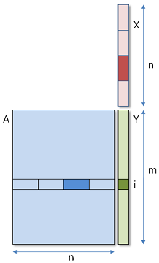
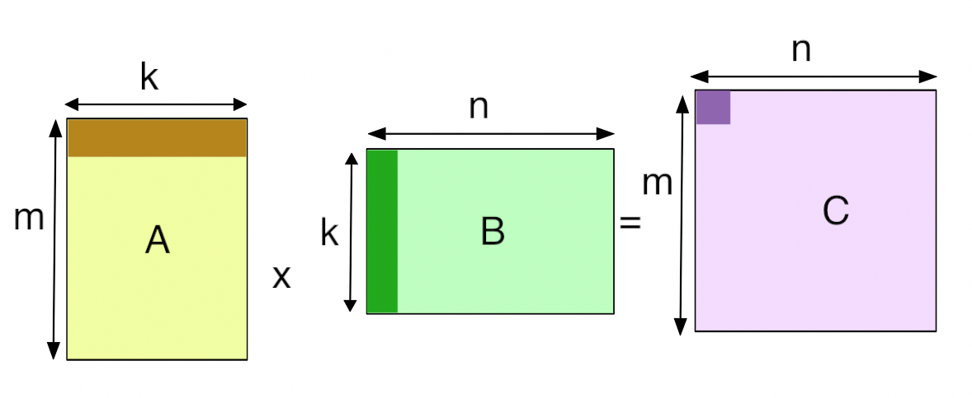
Background & Motivation
Over the last decade, AI-like applications have seen a steep rise in popularity.
For many of these applications, two BLAS kernels make up a large part of their compute time:
Matrix-Matrix Multiply (GEMM)
Matrix-Vector Multiply (GEMV)
These BLAS kernels are also widely used in many “traditional” HPC applications, but often make up a smaller part of total compute^{[1,2]}.
[1] H. Waugh and S. McIntosh-Smith, “On the Use of BLAS Libraries in Modern Scientific Codes at Scale”, 2020
[2] J. Domke et. al “Matrix Engines for High Performance Computing: A Paragon of Performance or Grasping at Straws?” , IPDPS 2021
2

Slide 3
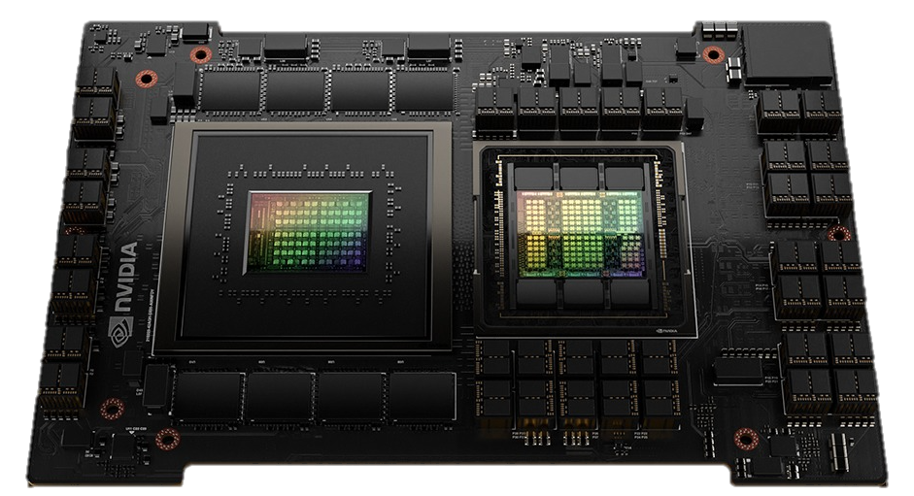
Background & Motivation
We are also seeing a consistent rise in heterogeneous HPC systems:
More systems are utilising GPUs or other types of accelerators
Top500 June 2017 had 91 heterogeneous systems
Top500 June 2024 had 193 heterogeneous systems
Furthermore, CPUs and GPUs (and node architectures in general) are being brought closer together with SoC devices:
Reduces GPU Offload penalties & permits unified address spaces
NVIDIA’s GH200 Superchip: Grace CPU + H100 GPU connected via NVLink-C2C
AMD’s MI300A: Zen4-based CPU + GPU with a single unified address
3
Notes:
June 2017 - ~18% of systems have an accelerator
June 2024 - ~39% of systems have an accelerator (2.1X increase)

Slide 4
Background & Motivation
As we can see, the HPC hardware landscape is rapidly changing
With GPUs becoming more and more common it can be easy to assume you should always use one if available!
However, this is not always the case and porting an application to utilise a GPU can take a significant amount of time and effort…
4

Slide 5
Background & Motivation
Hence, we see it highly relevant to answer the following questions:
How can I know if my GEMM / GEMV-enabled application will benefit from a GPU before porting the code?
Should modern CPUs perform GEMM or GEMV computations in modern heterogeneous systems?
Do the following mantras still hold true for SoC devices?
GEMM typically performs better on GPU
GEMV typically performs better on CPU
?
?
?
5

Slide 6
Benchmark Overview
To help answer these questions, we developed the
GPU BLAS Offload Benchmark;
GPU-BLOB is designed to be:
Portable: such that all main vendor & open-source BLAS libraries, and all main compilers are supported
Diverse: such that it collects performance data for a range of problem types
Complete: such that it produces a “GPU offload threshold” for every BLAS kernel and problem type pairing
or GPU-BLOB
6

Slide 7
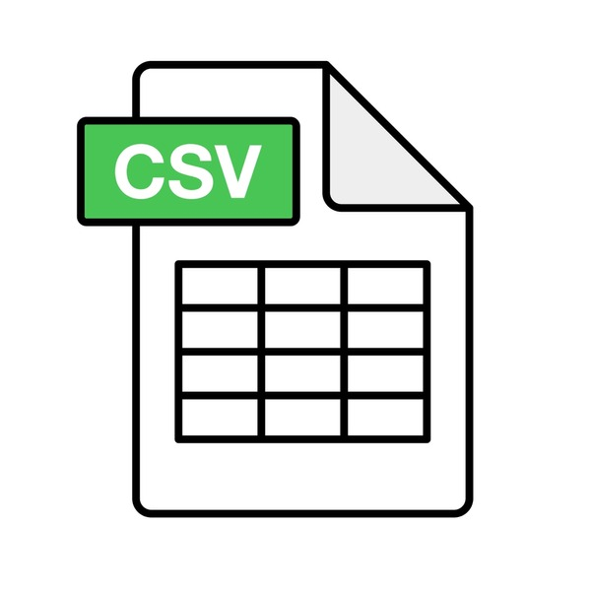
Benchmark Overview
Unlike libraries such as MAGMA, GPU-BLOB compares CPU and GPU performance rather than employing a heterogeneous computational effort
We want to find when offloading a given BLAS computation to the GPU becomes worthwhile
GPU-BLOB measures performance (GFLOP/s) for every possible problem size
User defines a min and max dimension size at runtime
Adheres with a problem type’s inter-dimension relationship
Performance measurement is for `i` back-to-back BLAS computations
Including data movement overhead for GPU
`i` defined by user at runtime
GPU-BLOB outputs:
Performance data for every problem size in CSV files
Tables printed to stdout of each problem type’s GPU Offload Threshold
7

Slide 8
Benchmark Overview – GPU Offload Threshold
We define the GPU Offload Threshold as:
“For a given BLAS kernel, problem type, and iteration count; the GPU Offload Threshold is the set of BLAS dimensions at which all greater problem sizes for the specific problem type are guaranteed to benefit from GPU acceleration.”
The GPU Offload Threshold is system and library specific.
Can be used to help indicate if a certain application with substantial BLAS usage may benefit from GPU acceleration
GPU Offload Threshold
8

Slide 9
Benchmark Overview – GPU Data Transfer
There are many ways to move data to/from the GPU
We employ three different approaches in GPU-BLOB:
Transfer-Once: Move data to GPU, do `i` BLAS computations, move data to CPU
Transfer-Always: Move data to GPU, do one BLAS computation, move data to CPU; repeat `i` times
Unified Shared Memory: Same as Transfer-Once, but using USM constructs
A B C A x y
C y
9
Notes:
Transfer-Always is “dumb” but is typical of a real science app which hasn’t yet ported to GPU.
It also represents applications that have some intermediary stage between each BLAS call that requires host execution.

Slide 10
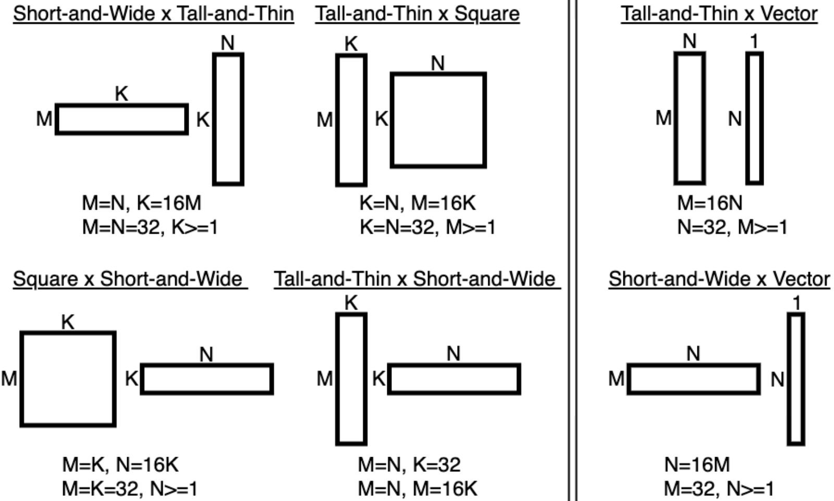
Benchmark Overview – Problem Types
Alongside square problems (M=N=K and M=N), we also used a variety of non-square problems as many real applications use these irregular shapes.
GEMM Non-Square Problems
GEMV Non-Square Problems
10
Notes:
Irregular matrix applications = K-means clustering, LU Factorization, Neural Networks, etc.
Rectangular matrix shapes can help to:
Highlight irregular performance trends in BLAS libraries
Make GPU-BLOB useful / relevant for more applications
Irregular problem types chosen so that we have:
Scaling irregular matrix(ies)
Matrix(ies) with at least one dimension fixed to a small value
Not based of any real application shapes, but looking to add to GPU-BLOB to make adding / controlling problem types tested easier.

Slide 11
Methodology – Systems & Configuration
System | CPU | GPU | Compiler | Main CPU Library | Main GPU Library
DAWN (University of Cambridge) | Intel Xeon Platinum 8468 | Intel Data Center GPU Max 1550 | icpx 2024.1.0 | OneMKL 2024.1 CBLAS interface | OneMKL 2024.1 DPC++ interface
LUMI (EuroHPC) | AMD EPYC 7A53 | AMD MI250X | g++ 7.5 hipcc 5.2.3 | AOCL 4.1 | rocBLAS 5.2.3
Isambard-AI¹ (University of Bristol) | NVIDIA Grace-Hopper GH200 Superchip |  | nvc++ 24.5 | NVPL 24.7 | cuBLAS 24.5
Single CPU socket and Single GPU targeted
BLAS calls typically aren’t parallelized across socket/device
DAWN GPU used a single tile, not both (Explicit Scaling)
Tensor cores (or equivalent) targeted when possible
Minimum dimension value = 1; maximum dimension value = 4096
Iteration counts ∈ {1, 8, 32, 64, 128}
¹Results for Isambard-AI were collected through an early access programme and before full system acceptance.
11

Slide 12
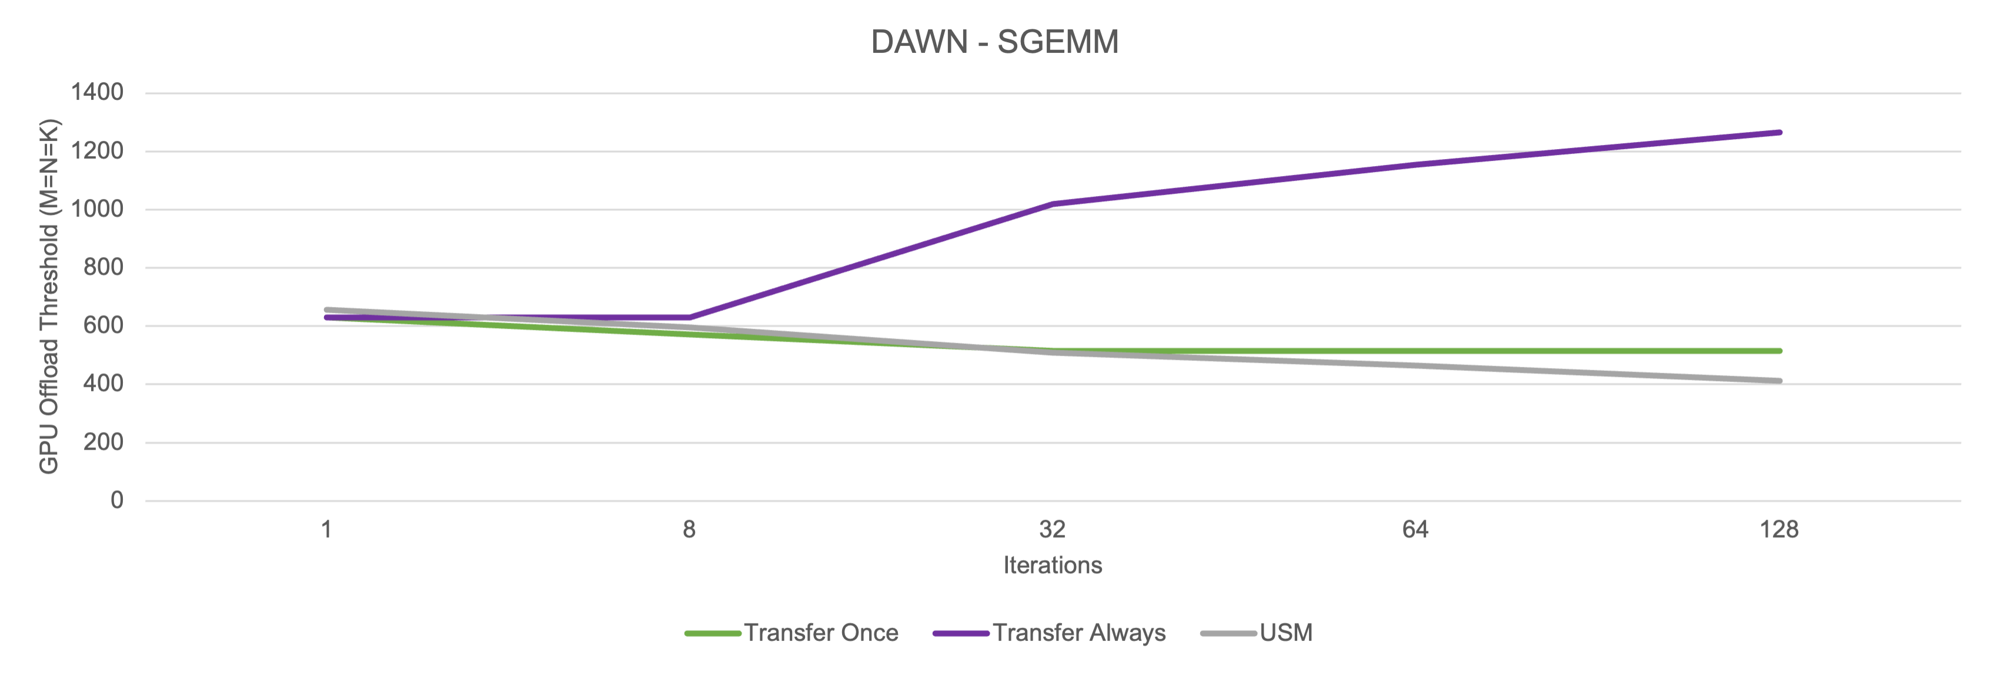
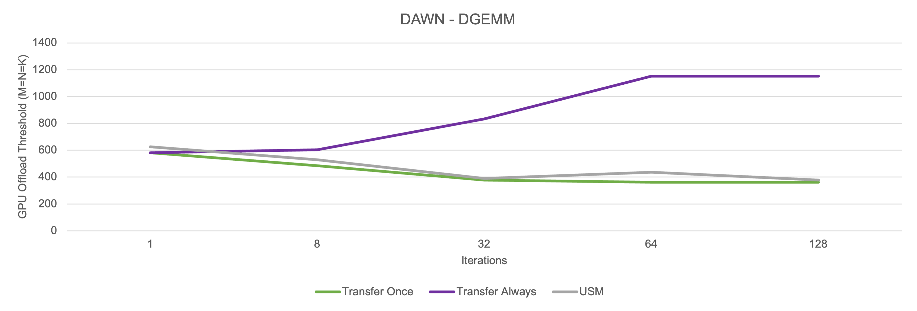
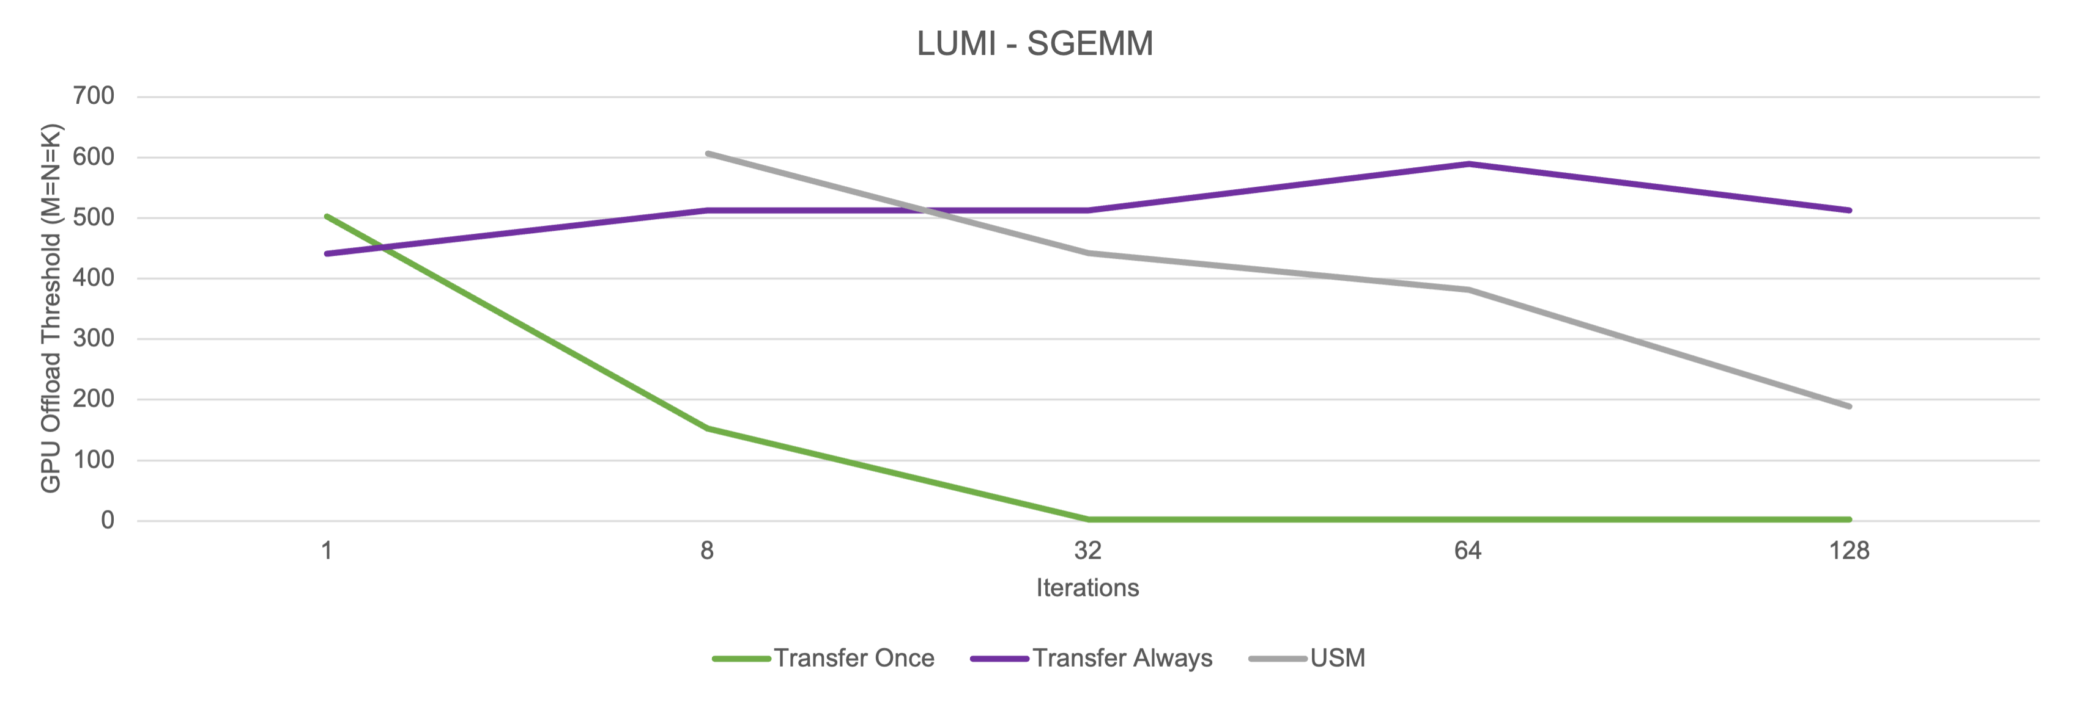
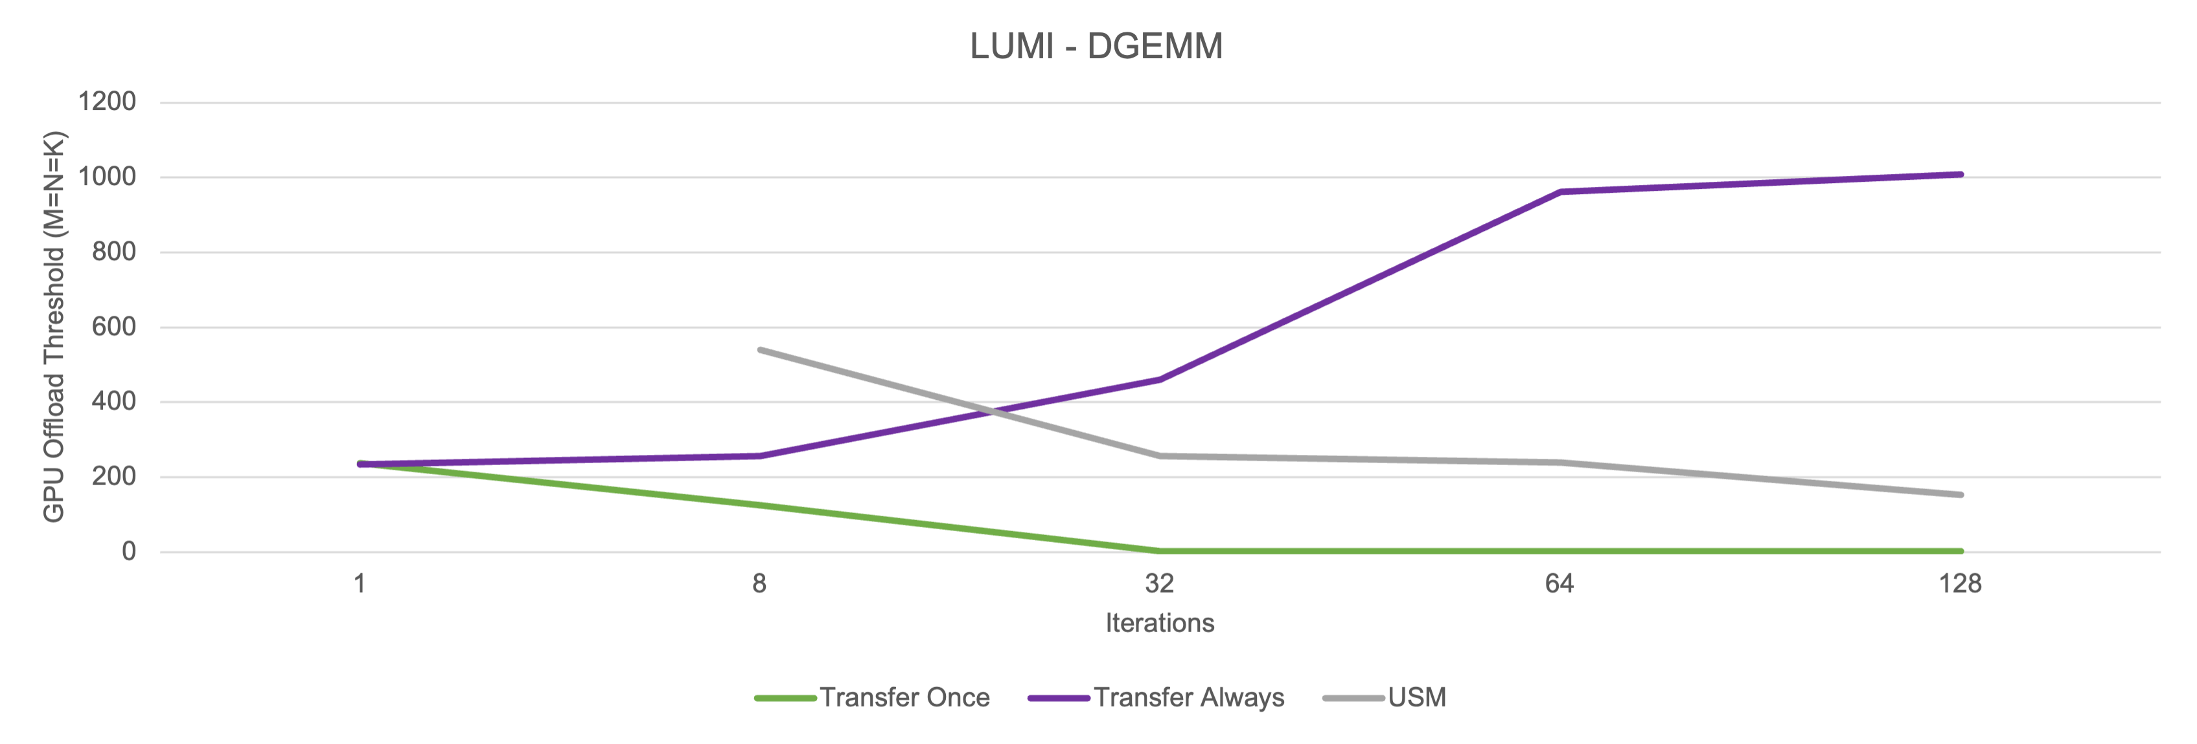
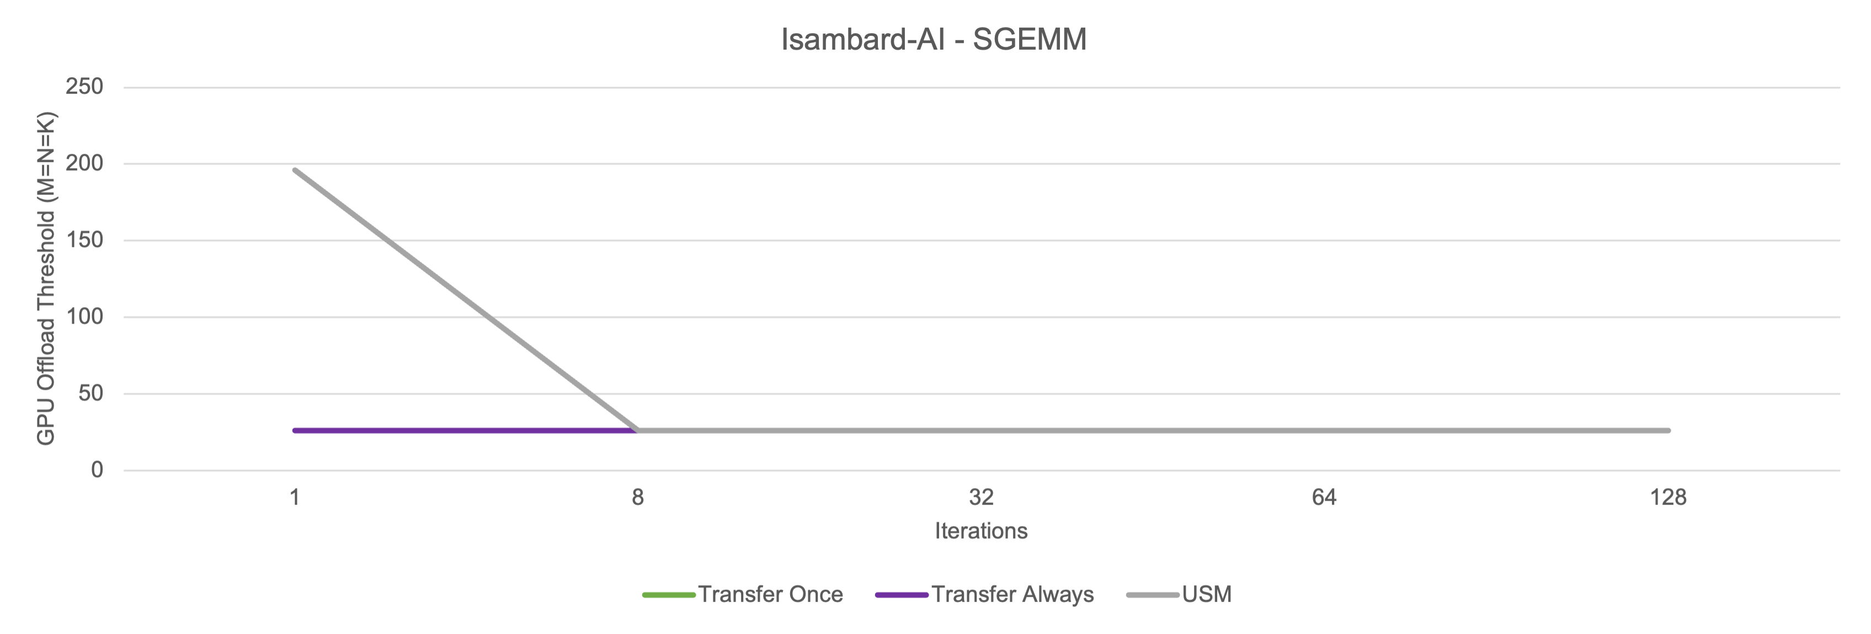
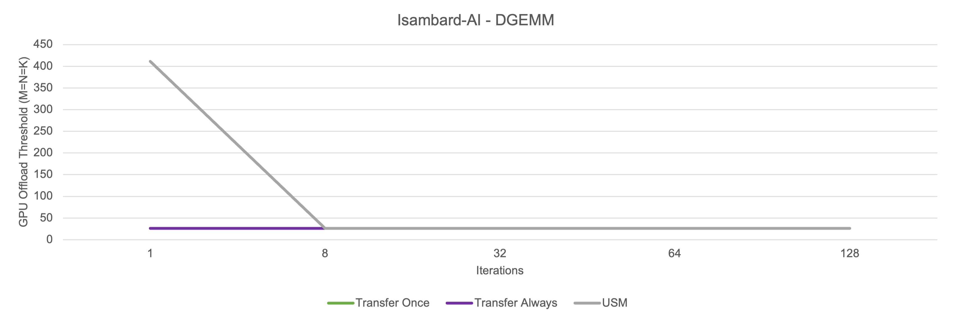
Results – Square GEMM
12
Notes:
LUMI lower thresholds than DAWN as CPU : GPU performance ratio is higher.
IsamAI has very low offload threshold, but this is in part due to the BLAS library. More details in paper but being SoC still gives huge advantage regardless.

Slide 13
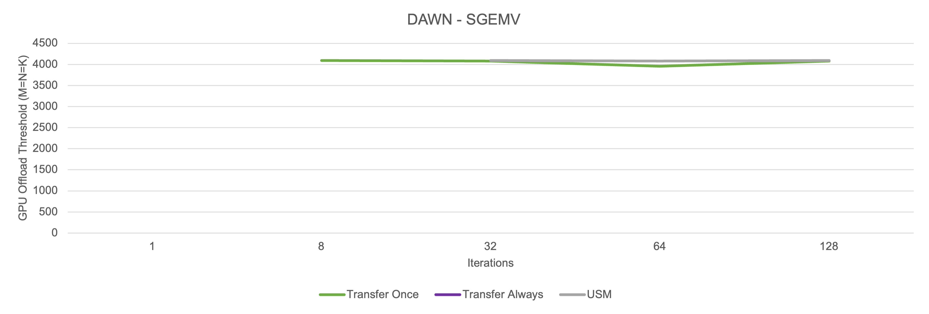
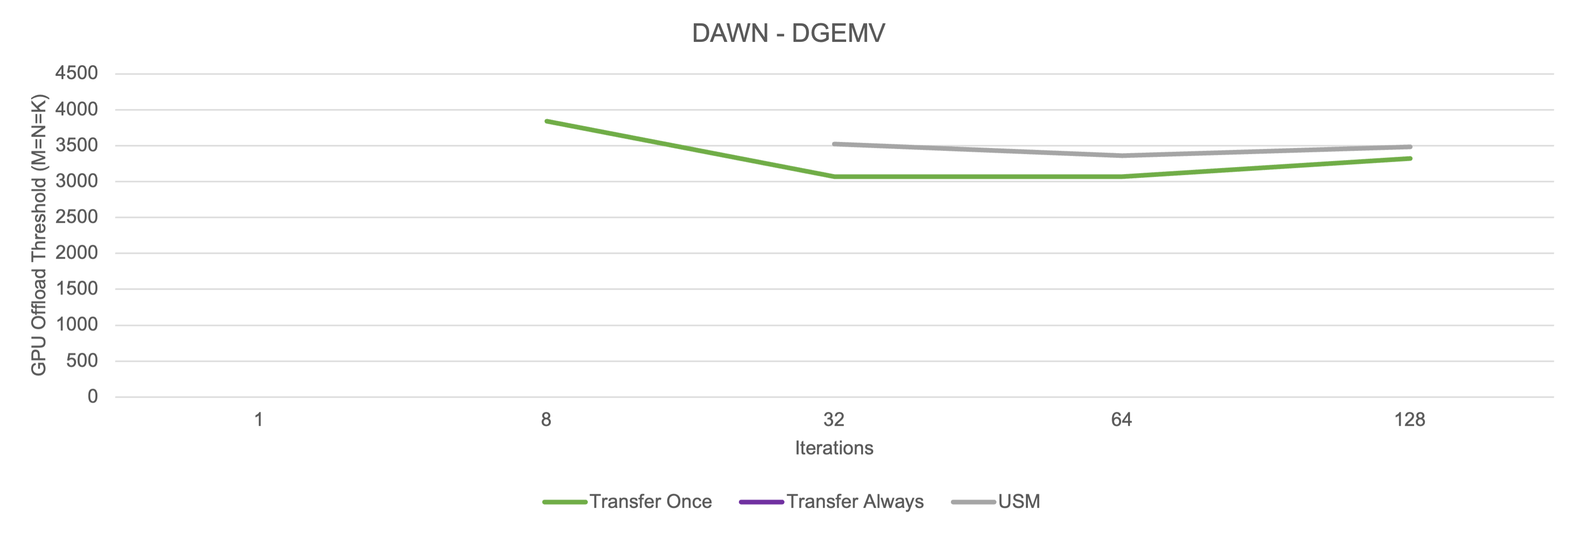
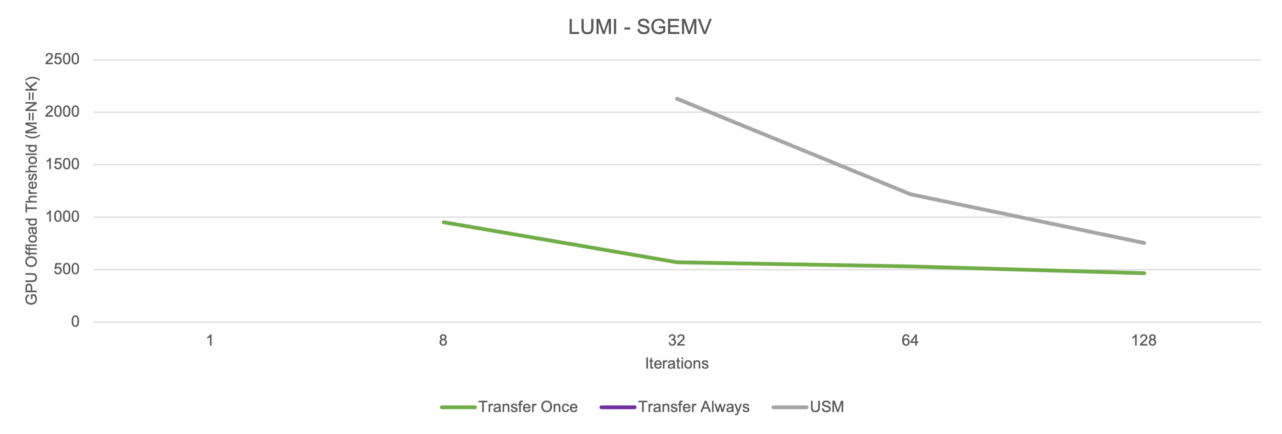
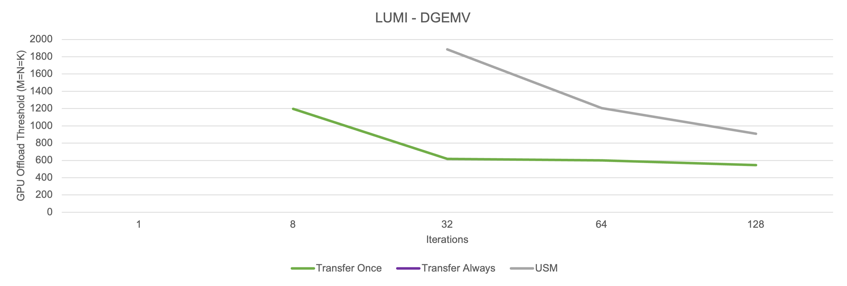
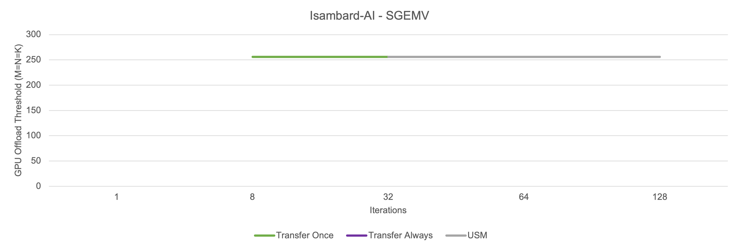
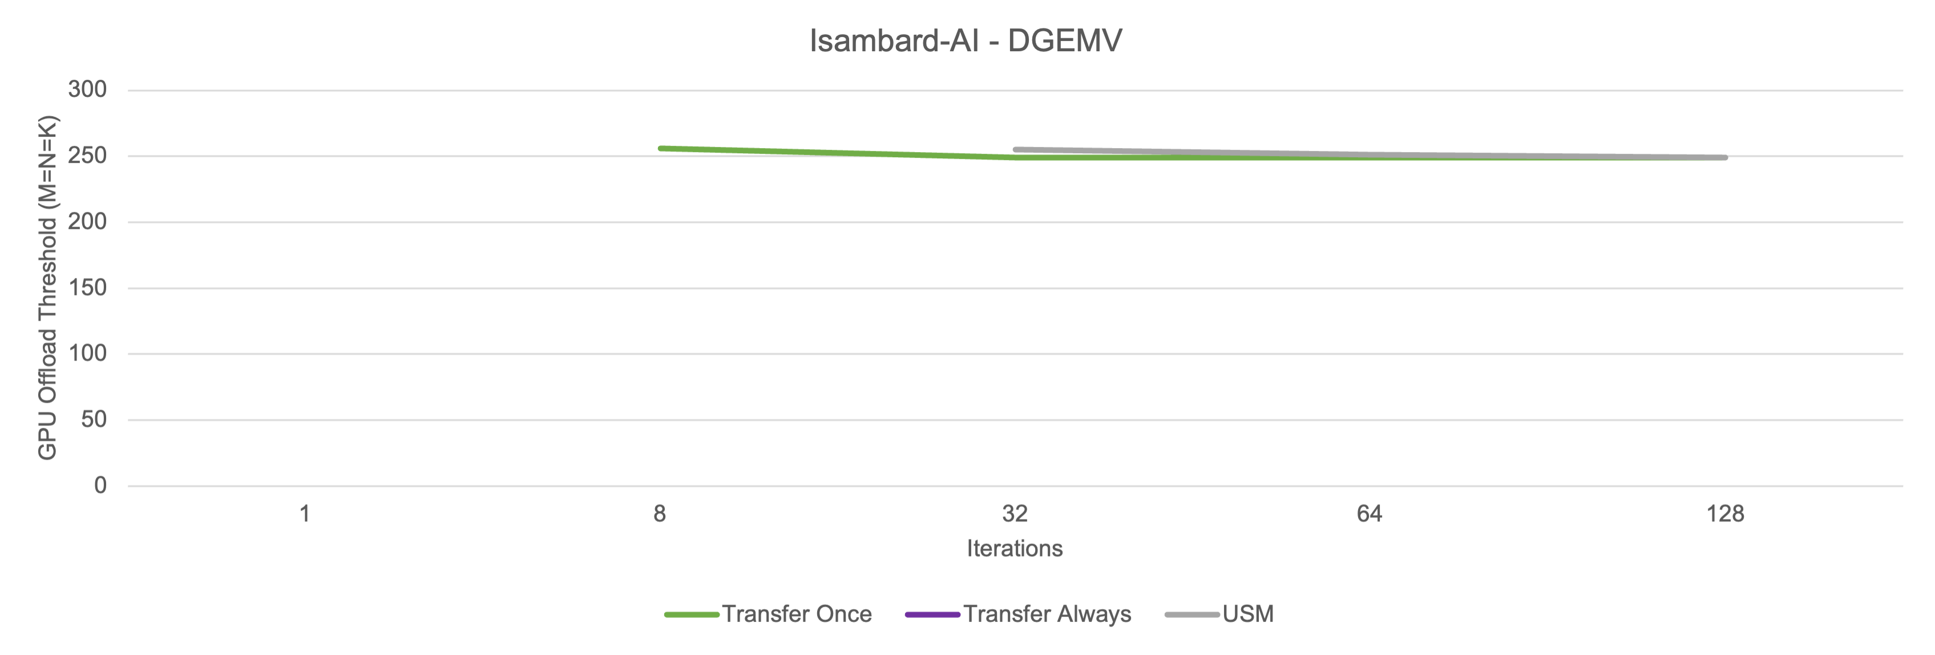
Results – Square GEMV
)
)
)
)
)
)
13
Notes:
On all systems:
Transfer Always never yields an offload threshold.
1 iteration never yields an offload threshold for any transfer type
GEMV higher offload threshold than GEMM as low arithmetic intensity; less work done so offload cost not amortized as quickly.
LUMI has exceptionally low offload thresholds as single threaded AOCL GEMV implementation. More details in paper.

Slide 14
Results – BLAS Library Oddities
)
)
At one iteration, many small->large problems would benefit from GPU
GPU Offload Threshold does not always paint the full picture on its own
In <5% of problems tested, performance graph showed similar to the above
14
Notes:
BLAS library sees consistent dip at 256x256
Without this dip, CPU may always beat GPU

Slide 15
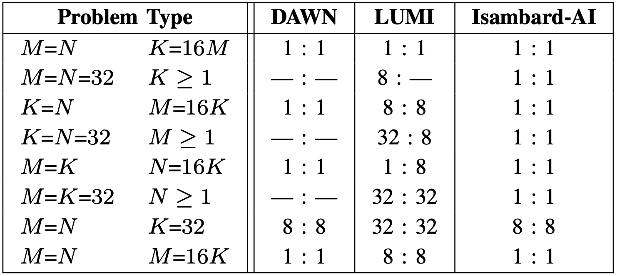
Results – Non-Square GEMM
No Transfer-Always offload thresholds for `i` > 1 on DAWN & LUMI
All GPU data transfer types yielded very similar results on Isambard-AI
USM performance compared to Transfer-Once in-line with square GEMM
Iteration count at which offload threshold was first yielded.
SGEMM : DGEMM
15
Notes:
On DAWN, problems with lower arithmetic intensity (2 dims set to 32) never yield an offload threshold.
LUMI results are very mixed and display no cohesive pattern or trend.
DAWN and LUMI thresholds moderate-large and steadily decreased
Isambard-AI offload thresholds all small.
For 8 iters, at 1 iter again many small-medium problems would benefit from GPU

Slide 16
Results – Non-Square GEMV
Iteration count at which offload threshold was first yielded.
SGEMV : DGEMV
No offload thresholds on DAWN whatsoever
LUMI offload thresholds stayed large when present
No Transfer-Once thresholds
Isambard-AI offload thresholds at 1 iteration often medium-to-large
Decreased rapidly as iteration count increased
16

Slide 17
Conclusions
How can I know if my GEMM- / GEMV-enabled application will benefit from a GPU before porting the code?
Should modern CPUs perform GEMM or GEMV computations in modern heterogeneous systems?
Do the following mantras still hold true for SoC devices?
GEMM typically performs better on GPU
GEMV typically performs better on CPU
GPUs on SoCs dominate for most GEMM and GEMV problems
Additionally:
USM makes GPU porting easier; but can come at the cost of performance with some vendors!
Use GPU-BLOB to measure CPU & GPU performance and find the GPU Offload Threshold!
It depends! Problem shape, problem size, system hardware, BLAS library, data movement frequency all contribute to realised GPU performance
YES
NO
17

Slide 18
Future Work
Continuing from this work, we plan to investigate:
Sparse GEMM and GEMV
Currently in progress…
The effect CPU matrix engines have on the GPU offload threshold
i.e. Intel AMX, IBM MMA, Arm SME
Lower precision kernels to get more AI / mixed-precision relevant results
FP16, BF16, INT8, etc.
Batched kernels
GPU offload thresholds for more systems & a wider range of hardware
18

Slide 19
Thank you for listening!
GPU-BLOB: https://github.com/UoB-HPC/GPU-BLAS-Offload-Benchmark
Contacts:
Finn Wilkinson (fw17231@Bristol.ac.uk)
Dr. Tom Deakin (tom.deakin@bristol.ac.uk)
Prof. Simon McIntosh-Smith (s.mcintosh-smith@bristol.ac.uk)
19

